Slide 1
Probabilistic Robotics
Probability Theory Basics
Error Propagation
Slides from Autonomous Robots (Siegwart and Nourbaksh), Chapter 5
Probabilistic Robotics (S. Thurn et al. ), Jana Kosecka

Slide 2
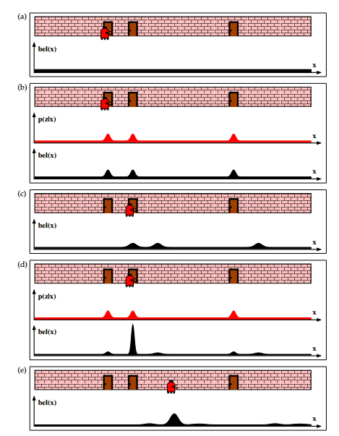
Motivating example: Global Localization
Notes:
Robot is placed in somewhere in a known environment and has to localize itself.
At the beginning: uniform distribution over the space of locations. (b) belief after taking measurements; there is an uncertainty in the measurements
(c) belief after robot moves; the movement also has an uncertainty.
(d) belief after the robot takes new sensor measurements
(e) belief after the robot moves again

Slide 3
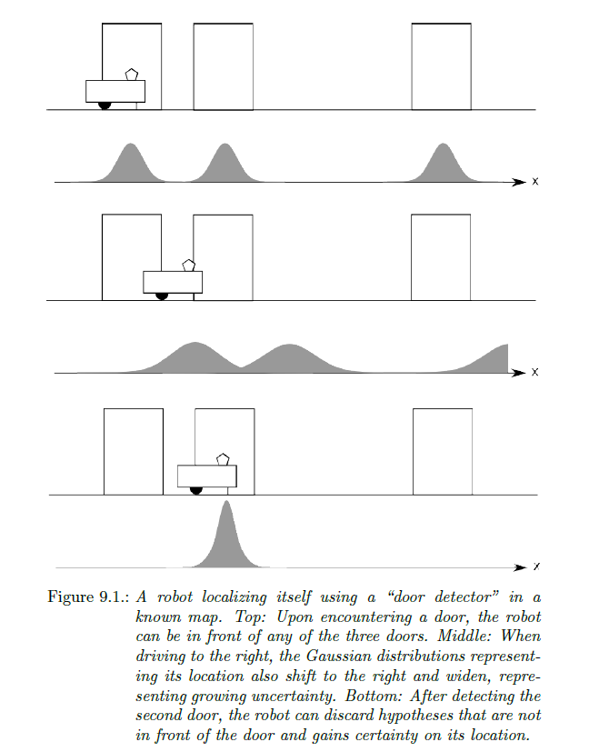
Motivating example Localization

Slide 4
Probabilistic Robotics
Key idea: Explicit representation of uncertainty using the calculus of probability theory
Perception = state estimation
Action = utility optimization

Slide 5
Axioms of Probability Theory
Pr(A) denotes probability that proposition A is true.

Slide 6
A Closer Look at Axiom 3
B

Slide 7
Discrete Random Variables
X denotes a random variable.
X can take on a countable number of values in {x₁, x₂, …, x_{n}}.
P(X=x_{i}), or P(x_{i}), is the probability that the random variable X takes on value x_{i}.
P( ) is called probability mass function.
E.g.
.

Slide 8
Continuous Random Variables
X takes on values in the continuum.
p(X=x), or p(x), is a probability density function.
E.g.
p(x)
x

Slide 9
Joint and Conditional Probability
P(X=x and Y=y) = P(x,y)
If X and Y are independent then P(x,y) = P(x) P(y)
P(x | y) is the probability of x given y P(x | y) = P(x,y) / P(y) P(x,y) = P(x | y) P(y)
If X and Y are independent then P(x | y) = P(x)

Slide 10
Law of Total Probability, Marginals
Discrete case
Continuous case

Slide 11
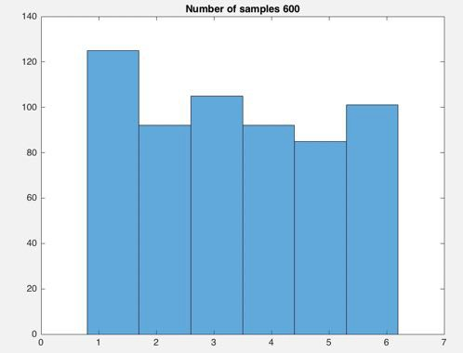
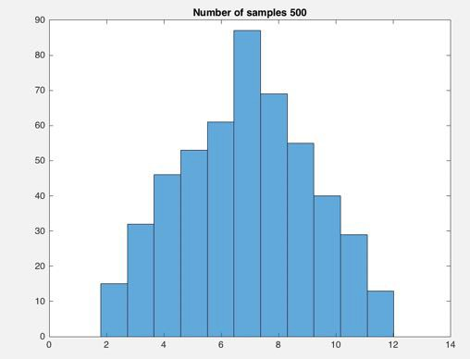
Example: Throwing dice
Idea of formulating the combination of probabilities as filtering
One die: 4,5,1,3,2,4,5,2,2,6,7,8,…
Each variate has a probability of 1/6
Uniform distribution
What’s the distribution of the sum of two dice?
# of occurences
# of occurences

Slide 12
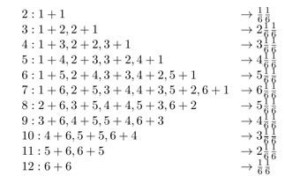





Sum of two probability distributions
Example
The distribution of the sum of two random variables is the convolution of their distributions.

Slide 13
Bayes Formula
Notes:
Bayes' Rule relates a conditional probability to its inverse. In
other words, if we know the probability of event Y to happen
given that event X is happening, we can calculate the probability
of X to occur given that Y is happening.
Bayes plays a dominant role in localization.
If x is the quantity we want to infer from y (data, e.g. sensor measurements). P(x) is the knowledge we have prior to sensor measurements. P(x|y) is called the posterior probability distribution over X.
In robotics, the probability P(y|x) is often called generative model, since it describes how state variable X cause sensor measurements Y.

Slide 14
Normalization
Algorithm:
Notes:
Denominator P(y) does not depend on x, and will be the same for all x. Thus 1/p(y) is often written as a normalizer in Bayes rule.

Slide 15
Law of total probability:

Slide 16
Bayes Rule with Background Knowledge
Notes:
Any of the rules can be conditioned on another random variable, z

Slide 17
Conditional Independence
equivalent to
and
But this does not necessarily mean
P(x, y )= P(x)P( y)
(independence/marginal independence)

Slide 18
Simple Example of State Estimation
Suppose a robot obtains measurement z
What is P(open|z)?

Slide 19
Causal vs. Diagnostic Reasoning
P(open|z) is diagnostic.
P(z|open) is causal.
Often causal knowledge is easier to obtain.
Bayes rule allows us to use causal knowledge:
count frequencies!

Slide 20
Example
P(z|open) = 0.6 P(z|¬open) = 0.3
P(open) = P(¬open) = 0.5
z raises the probability that the door is open.
Here the robot senses open

Slide 21
Combining Evidence
Suppose our robot obtains another observation z₂.
How can we integrate this new information?
More generally, how can we estimate P(x| z₁...z_{n} )?

Slide 22
Recursive Bayesian Updating
Markov assumption: z_{n} is independent of z₁,...,z_{n-1} if we know x.

Slide 23
Example: Second Measurement
P(z₂|open) = 0.5 P(z₂|¬open) = 0.6
P(open|z₁)=2/3
z₂ lowers the probability that the door is open.

Slide 24
Actions
Often the world is dynamic since
actions carried out by the robot,
actions carried out by other agents,
or just the time passing by
change the world.
How can we incorporate such actions?

Slide 25
Typical Actions
The robot turns its wheels to move
The robot uses its manipulator to grasp an object
Plants grow over time…
Actions are never carried out with absolute certainty.
In contrast to measurements, actions generally increase the uncertainty.

Slide 26
Modeling Actions
To incorporate the outcome of an action u into the current “belief”, we use the conditional pdf
P(x|u,x’)
This term specifies the pdf that executing u changes the state from x’ to x.

Slide 27
Example: Closing the door

Slide 28
State Transitions
P(x|u,x’) for u = “close door”:
If the door is open, the action “close door” succeeds in 90% of all cases.

Slide 29
Integrating the Outcome of Actions
Continuous case:
Discrete case:

Slide 30
Example: The Resulting Belief

Slide 31
Bayes Filters: Framework
Given:
Stream of observations z and action data u:
Sensor model P(z|x).
Action model P(x|u,x’).
Prior probability of the system state P(x).
Wanted:
Estimate of the state X of a dynamical system.
The posterior of the state is also called Belief:

Slide 32
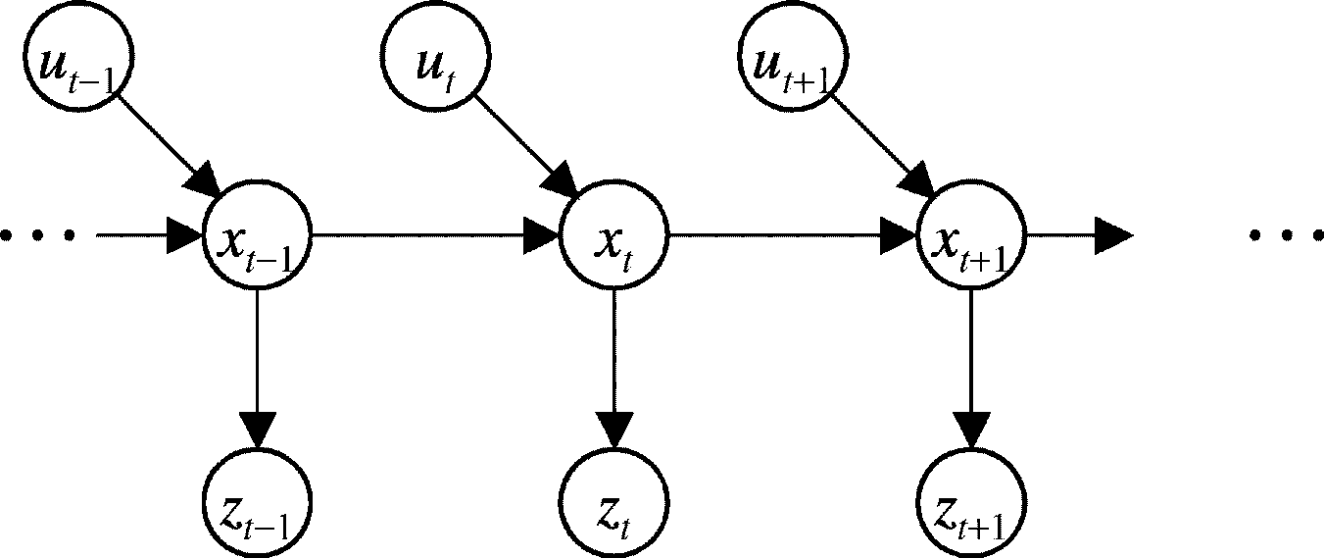
Markov Assumption
Underlying Assumptions
Static world
Independent noise
Perfect model, no approximation errors

Slide 33
Bayes Filters
z = observation
u = action
x = state
Bayes
Markov
Total prob.
Markov
Markov

Slide 34
Bayes Filter Algorithm
Algorithm Bayes_filter( Bel(x),d ):
η=0
If d is a perceptual data item z then
For all x do
For all x do
Else if d is an action data item u then
For all x do
Return Bel’(x)

Slide 35
Bayes Filters are Familiar!
Kalman filters
Particle filters
Hidden Markov models
Dynamic Bayesian networks
Partially Observable Markov Decision Processes (POMDPs)

Slide 36
Summary
Bayes rule allows us to compute probabilities that are hard to assess otherwise.
Under the Markov assumption, recursive Bayesian updating can be used to efficiently combine evidence.
Bayes filters are a probabilistic tool for estimating the state of dynamic systems.

